Slide 1


| Tech Management, SRI-B
CLAWS
CLASH OF THE
<RVCE>_<Team Nexus>
<Risk-Aware AI for Intelligent Trading>
<Yarragunta Chandrakala>
<Varshini>

Slide 2
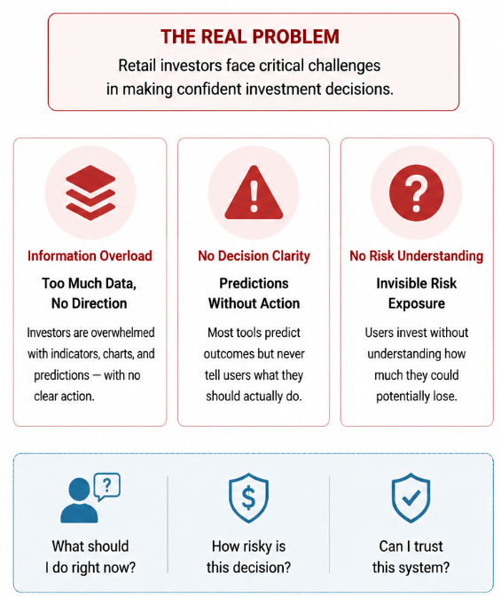
Idea
Problem Statement
Theme:- On-Device AI + GenAI Research
Problem:-
Retail investors face information overload from charts,predictions,etc.
Existing platforms provide forecasts but no clear decision guidance.
Most systems lack transparency and risk awareness.
Who Faces it ( persona):-
Retail investors
Beginner traders
Users without professional financial advisory access
Why is it important:-
Without explainability and risk analysis:
Users cannot trust AI decisions
Risk exposure remains invisible
Poor financial decisions become more common
Key User Questions
❝ What should I do right now? ❞ ❝ How risky is this decision? ❞ ❝ Can I trust this system? ❞

Slide 3
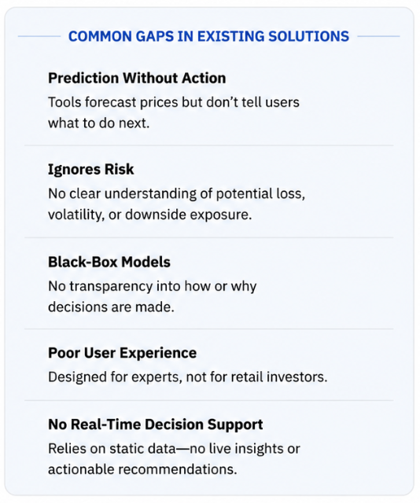
Idea
Current Solution & Gaps
Existing Tools:-
Prediction platforms like TradingView, robo-advisors, and stock screeners provide market forecasts and analytics for investors.
What’s Missing / Broken
Predictions without actionable buy/sell/hold guidance.
Black-box AI models with no explainability.
No risk quantification such as VaR or volatility analysis.
Complex interfaces designed mainly for experts .
Reliance on static historical data with limited real-time decision support.
Opportunity
Build an end-to-end AI platform that bridges the gap between market prediction and confident decision-making through:
Explainable AI
Risk-aware insights
Real-time recommendations
Retail-first user experience

Slide 4
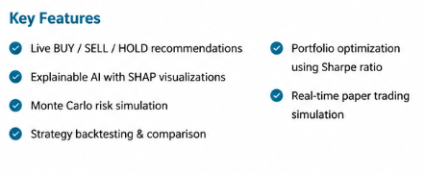
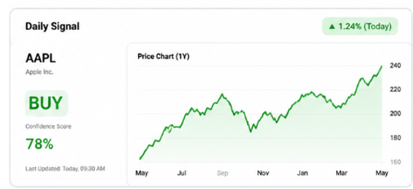
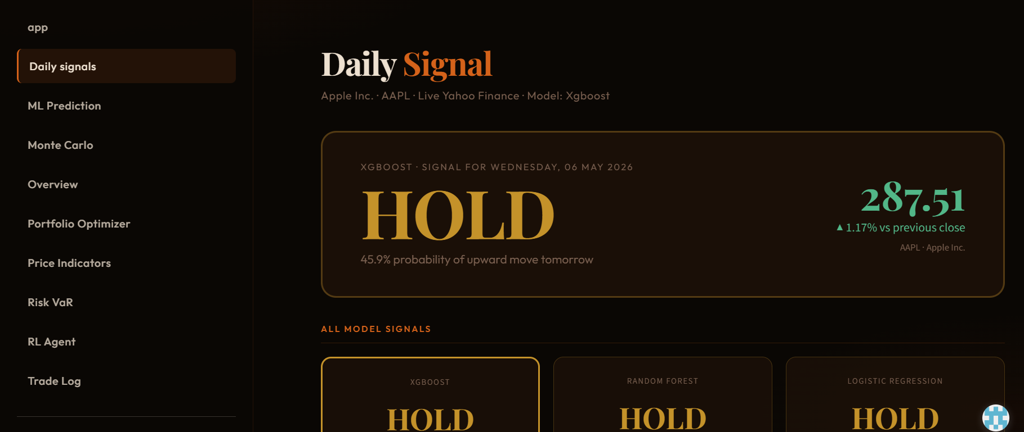
Idea
Your Solutions
What We Built
An end-to-end AI-powered investment platform that transforms live market data into explainable, risk-aware, and actionable trading decisions for retail investors.
Core Components
ML Prediction Engine
Predicts short-term market direction using models like XGBoost, Random Forest, and Logistic Regression.
Reinforcement Learning Agent
Learns Buy, Sell, and Hold strategies by maximizing long-term portfolio reward.
Risk Analysis Engine
Calculates Value at Risk (VaR), volatility, drawdown, and downside exposure before decisions are made.
Explainable AI Layer
Uses SHAP explainability to show which indicators influenced every prediction.

Slide 5
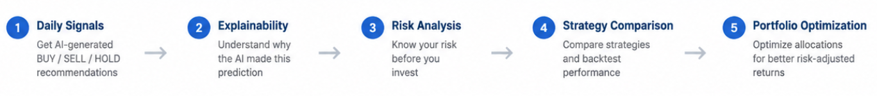
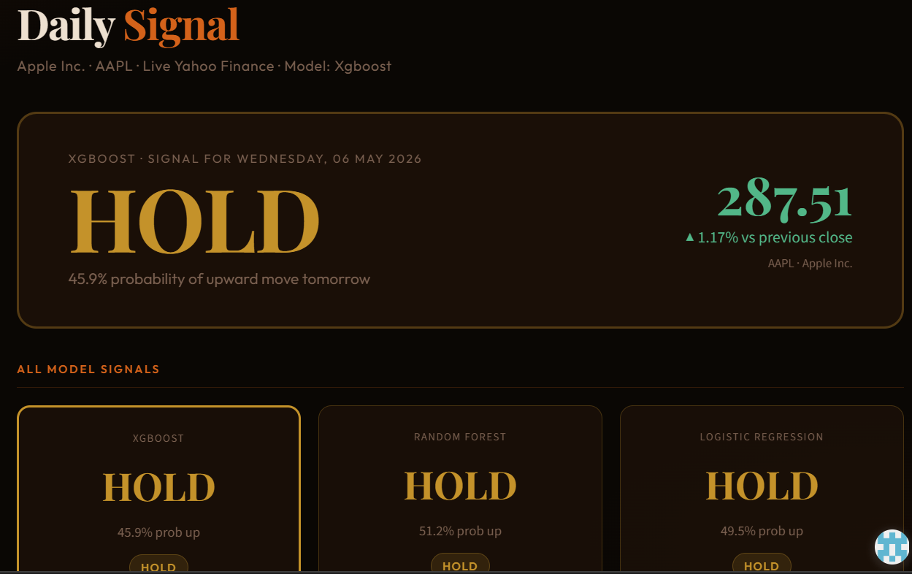
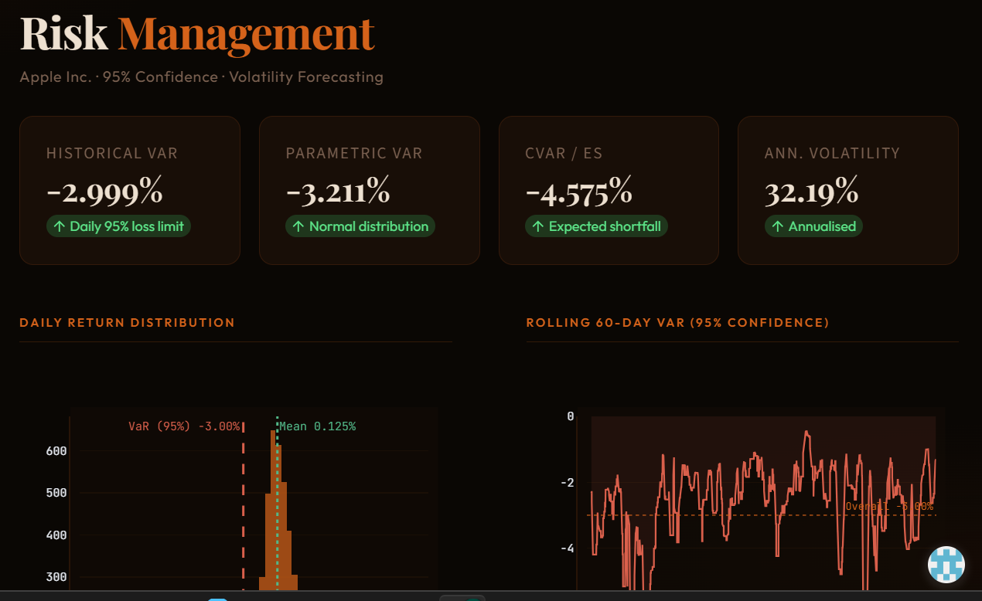
Idea
Demo/Product Walkthrough
Live demo:-https://ai-trading-8yddslultqfz2hfv9yt32z.streamlit.app/

Slide 6
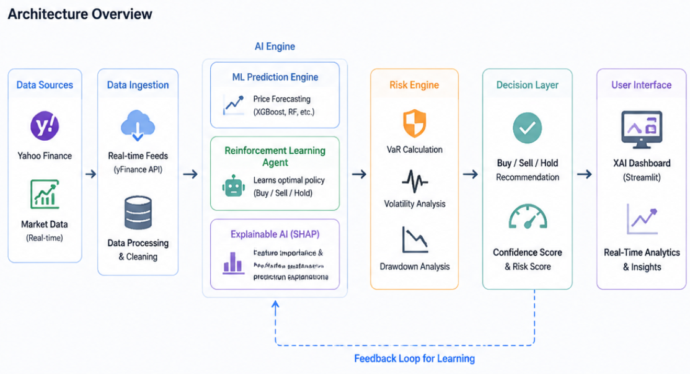
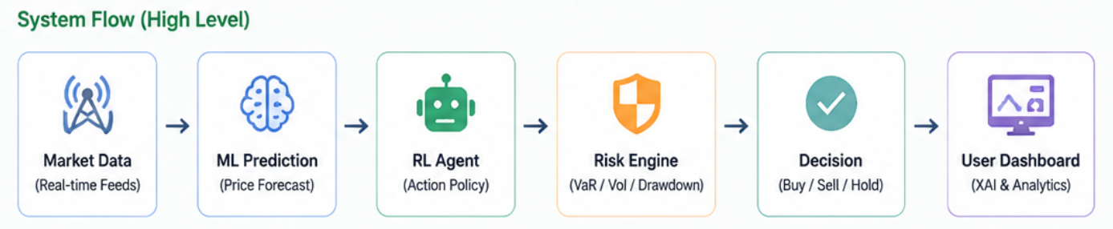
Idea
Tech & Architecture
Tech Stack
Python, pandas, NumPy
scikit-learn, XGBoost
Reinforcement Learning (RL)
SHAP Explainable AI
Plotly & Streamlit
Yahoo Finance API (yFinance)
AI Usage
ML models for market prediction
RL agent for Buy/Sell/Hold decision learning
SHAP for explainable AI and feature importance
VaR & volatility models for risk quantification
Architecture Highlights
Real-time market data ingestion
Explainable prediction pipeline
Risk-aware decision engine
Interactive analytics dashboard
End-to-end AI-powered workflow

Slide 7
Idea
Impact & Use cases
Scenario 1 — Retail Investor
A salaried individual managing a personal portfolio receives clear BUY / SELL recommendations with confidence scores, risk analysis, and explainable insights — without requiring financial expertise.
Scenario 2 — Beginner Trader
A first-time investor uses the paper-trading simulation mode to practice trading strategies risk-free while learning from SHAP-based AI explanations and performance analytics.
Scenario 3 — Underserved Individuals
Users without access to institutional advisory services gain affordable, AI-powered investment guidance directly through an intuitive dashboard experience.
Scale Potential
Intelligent advisory layer for retail investing
Cloud-ready deployment for brokerage integration
Federated learning for privacy-preserving model improvement
Scalable architecture for real-time financial analytics

Slide 8
Idea
Differentiation
Why Our Solution Stands Out
Prediction → Decision Intelligence
Unlike traditional prediction platforms, AlgoTrade AI delivers actionable BUY / SELL / HOLD recommendations with confidence scores and real-time insights.
Explainable AI (XAI)
SHAP-based explainability shows exactly which indicators influenced every recommendation, eliminating black-box decision making.
Built-In Risk Awareness
VaR, volatility, drawdown, and Monte Carlo analysis are integrated directly into the decision pipeline before recommendations are made.
Retail-First Experience
Designed specifically for retail investors with intuitive dashboards, simplified insights, and paper-trading support.
Strong MOAT 1
Explainability + Risk Integration
A unified platform combining live recommendations, explainable AI, and advanced financial risk modelling in one seamless workflow.
Strong MOAT 2
Privacy-First Local Architecture
Local-first processing with minimal external dependency, aligning with secure and privacy-aware AI ecosystems like Samsung PRISM.

Slide 9
Idea
Demo Link
Demo Link:- https://ai-trading-8yddslultqfz2hfv9yt32z.streamlit.app/
Video link:-https://drive.google.com/file/d/1O3QrUEcvy2YwzbpROsCx6HRuzUn1Wo_u/view?usp=sharing

